Slide 1
Cornerstone City Church Peninsula Plus Community Hoo Are Ya
18th January 2026

Slide 2
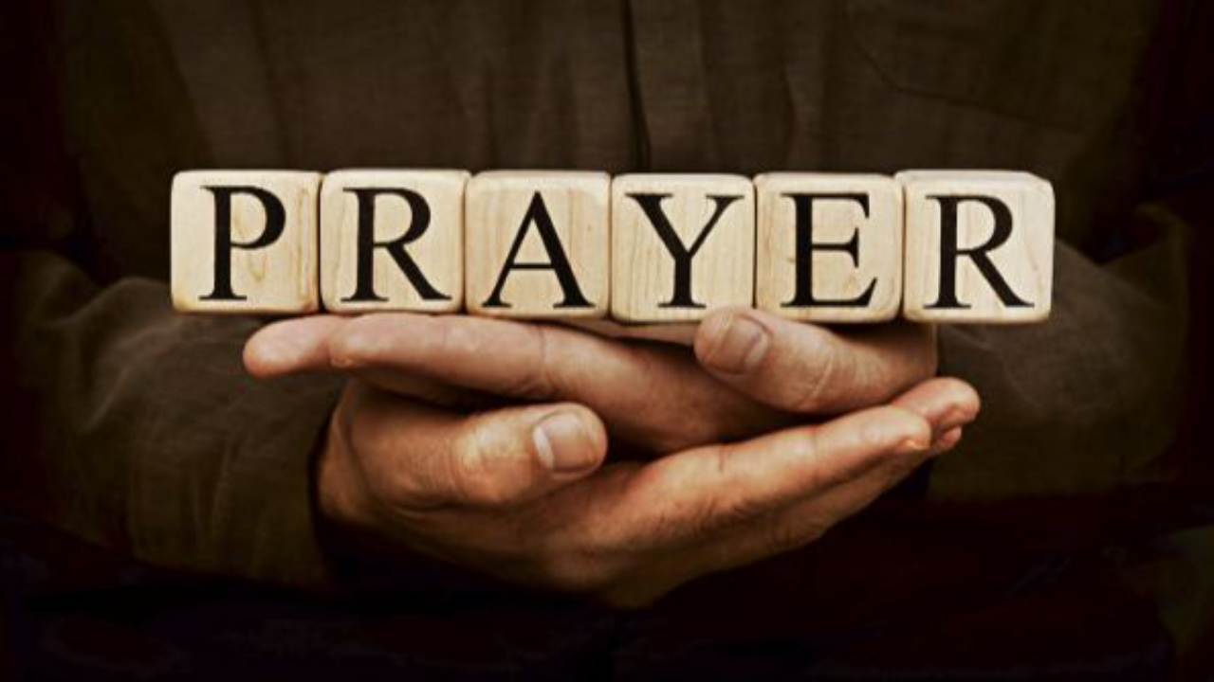

Slide 3
Great Big God
CCLI Song # 3373437
Jo Hemming | Nigel Hemming
© 2001 Vineyard Songs (UK/Eire) (Admin. by Integrity Music Ltd)
For use solely with the SongSelect® Terms of Use. All rights reserved. www.ccli.com
CCLI Licence No. 33265

Slide 4
1/2
Our God is a great big God
Our God is a great big God
Our God is a great big God
And He holds us in His hands

Slide 5
2/2
He's higher than a skyscraper
And He's deeper than a submarine
He's wider than the universe
And beyond my wildest dreams
And He's known me and He's loved me
Since before the world began
How wonderful to be a part of
God's amazing plan

Slide 6
This Is Amazing Grace
CCLI Song # 6333821
Jeremy Riddle | Josh Farro | Phil Wickham
© 2012 WC Music Corp. (Admin. by / Small Stone Media BV, Holland (Admin. in the UK/Eire by Song Solutions www.songsolutions.org))
Bethel Music Publishing (Admin. by Song Solutions)
Phil Wickham Music (Admin. by Song Solutions www.songsolutions.org)
Seems Like Music (Admin. by Song Solutions www.songsolutions.org)
Sing My Songs (Admin. by Song Solutions www.songsolutions.org)
For use solely with the SongSelect® Terms of Use. All rights reserved. www.ccli.com
CCLI Licence No. 33265

Slide 7
1/8
Who breaks the power of sin and darkness
Whose love is mighty and so much stronger
The King of Glory the King above all kings

Slide 8
2/8
Who shakes the whole earth with holy thunder
And leaves us breathless in awe and wonder
The King of Glory the King above all kings

Slide 9
3/8
This is amazing grace
This is unfailing love
That You would take my place
That You would bear my cross
You laid down Your life
That I would be set free
Oh Jesus I sing for all that You've done for me

Slide 10
4/8
Who brings our chaos back into order
Who makes the orphan a son and daughter
The King of Glory the King of Glory

Slide 11
5/8
Who rules the nations with truth and justice
Shines like the sun in all of its brilliance
The King of Glory the King above all kings

Slide 12
6/8
This is amazing grace
This is unfailing love
That You would take my place
That You would bear my cross
You laid down Your life
That I would be set free
Oh Jesus I sing for all that You've done for me

Slide 13
7/8
Worthy is the Lamb who was slain
Worthy is the King who conquered the grave
Worthy is the Lamb who was slain
Worthy is the King who conquered the grave
Worthy is the Lamb who was slain
Worthy is the King who conquered the grave
Worthy is the Lamb who was slain
Worthy worthy worthy

Slide 14
8/8
This is amazing grace
This is unfailing love
That You would take my place
That You would bear my cross
You laid down Your life
That I would be set free
Oh Jesus I sing for all that You've done for me

Slide 16
Open The Eyes of My Heart
CCLI Song # 2298355
Paul Baloche
© 1997 Integrity's Hosanna! Music (Admin. by Integrity Music Ltd)
For use solely with the SongSelect® Terms of Use. All rights reserved. www.ccli.com
CCLI Licence No. 33265

Slide 17
1/3
Open the eyes of my heart Lord
Open the eyes of my heart
I want to see You
I want to see You

Slide 18
2/3
To see You high and lifted up
Shining in the light of Your glory
Pour out Your power and love
As we sing holy holy holy

Slide 19
3/3
Holy holy holy
Holy holy holy
Holy holy holy
I want to see You

Slide 21
Goodness Of God
CCLI Song # 7117726
Ben Fielding | Brian Johnson | Ed Cash | Jason Ingram | Jenn Johnson
© 2018 Capitol CMG Paragon (Admin. by Capitol CMG Publishing)
Fellow Ships Music (Admin. by Essential Music Publishing LLC)
So Essential Tunes (Admin. by Essential Music Publishing LLC)
SHOUT! Music Publishing Australia (Admin. by SHOUT! Music Publishing UK)
Bethel Music Publishing (Admin. by Song Solutions)
For use solely with the SongSelect® Terms of Use. All rights reserved. www.ccli.com
CCLI Licence No. 33265

Slide 22
1/6
I love You Lord
Oh Your mercy never fails me
All my days
I've been held in Your hands
From the moment that I wake up
Until I lay my head
I will sing of the goodness of God

Slide 23
2/6
All my life You have been faithful
All my life You have been so so good
With every breath that I am able
I will sing of the goodness of God

Slide 24
3/6
I love Your voice
You have led me through the fire
In darkest night
You are close like no other
I've known You as a father
I've known You as a friend
I have lived in the goodness of God

Slide 25
4/6
All my life You have been faithful
All my life You have been so so good
With every breath that I am able
I will sing of the goodness of God

Slide 26
5/6
Your goodness is running after
It’s running after me
(REPEAT)
With my life laid down
I’m surrendered now
I give You everything
Your goodness is running after
It's running after me

Slide 27
6/6
All my life You have been faithful
All my life You have been so so good
With every breath that I am able
I will sing of the goodness of God

Slide 28
Bless God
CCLI Song # 7206380
Brandon Lake | Brooke Ligertwood | Cody Carnes
© 2023 Brandon Lake Music; Brooke Ligertwood Designee; Capitol CMG Paragon; Writer's Roof Publishing
For use solely with the SongSelect® Terms of Use. All rights reserved. www.ccli.com

Slide 29
1/11
Blessed are those who run to Him
Who place their hope and confidence in Jesus
He won’t forsake them
Blessed are those who seek His face
Who bend their knee and fix their gaze on Jesus
They won’t be shaken

Slide 30
2/11
Come on and praise the Lord with me
Sing if you love His name
Come on and lift your voice with me
He’s worthy of all our praise

Slide 31
3/11
Blessed are those who walk with Him
Whose hearts are set on pilgrimage with Jesus
They’ll see His glory
Blessed are those who die to live
Whose joy it is to give it all for Jesus
And for Him only
Oh Jesus all for Your glory

Slide 32
4/11
Come on and praise the Lord with me
Sing if you love His name
Come on and lift your voice with me
He’s worthy of all our praise

Slide 33
5/11
Come on and bring your offering
Sing if you’ve known His grace
Come on and lift up your holy hands
He’s worthy of all our praise

Slide 34
6/11
Bless God in the sanctuary
Bless God in the fields of plenty
Bless God in the darkest valley
Every chance I get I bless Your name

Slide 35
7/11
Bless God when my hands are empty
Bless God with a praise that costs me
Bless God when nobody’s watching
Every chance I get I bless Your name

Slide 36
8/11
Bless God when the weapon’s forming
Bless God when the walls are falling
Bless God ‘cause He goes before me
Every chance I get I bless Your name

Slide 37
9/11
Bless God for He holds the vict’ry
Bless God for He’s always with me
Bless God for He’s always worthy
Every chance I get I bless Your name
Every chance I get I bless Your name

Slide 38
10/11
Come on and praise the Lord with me
Sing if you love His name
Come on and lift your voice with me
He’s worthy of all our praise

Slide 39
11/11
Come on and bring your offering
Sing if you’ve known His grace
Come on and lift up your holy hands
He’s worthy of all our praise He’s worthy of all our praise

Slide 40


Slide 41
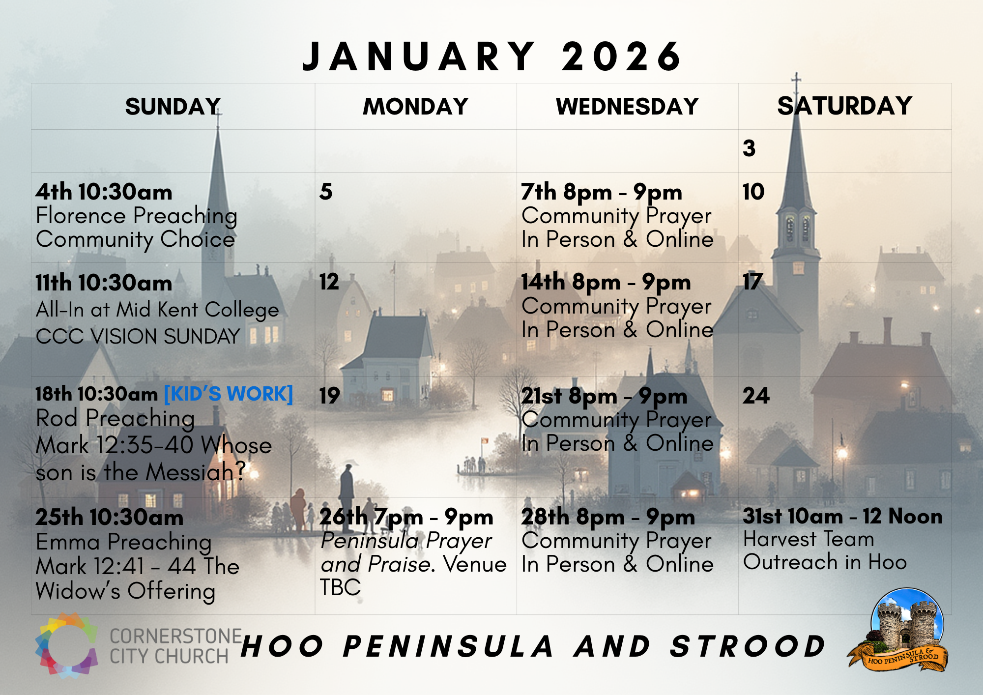

Slide 42


Slide 43


Slide 44
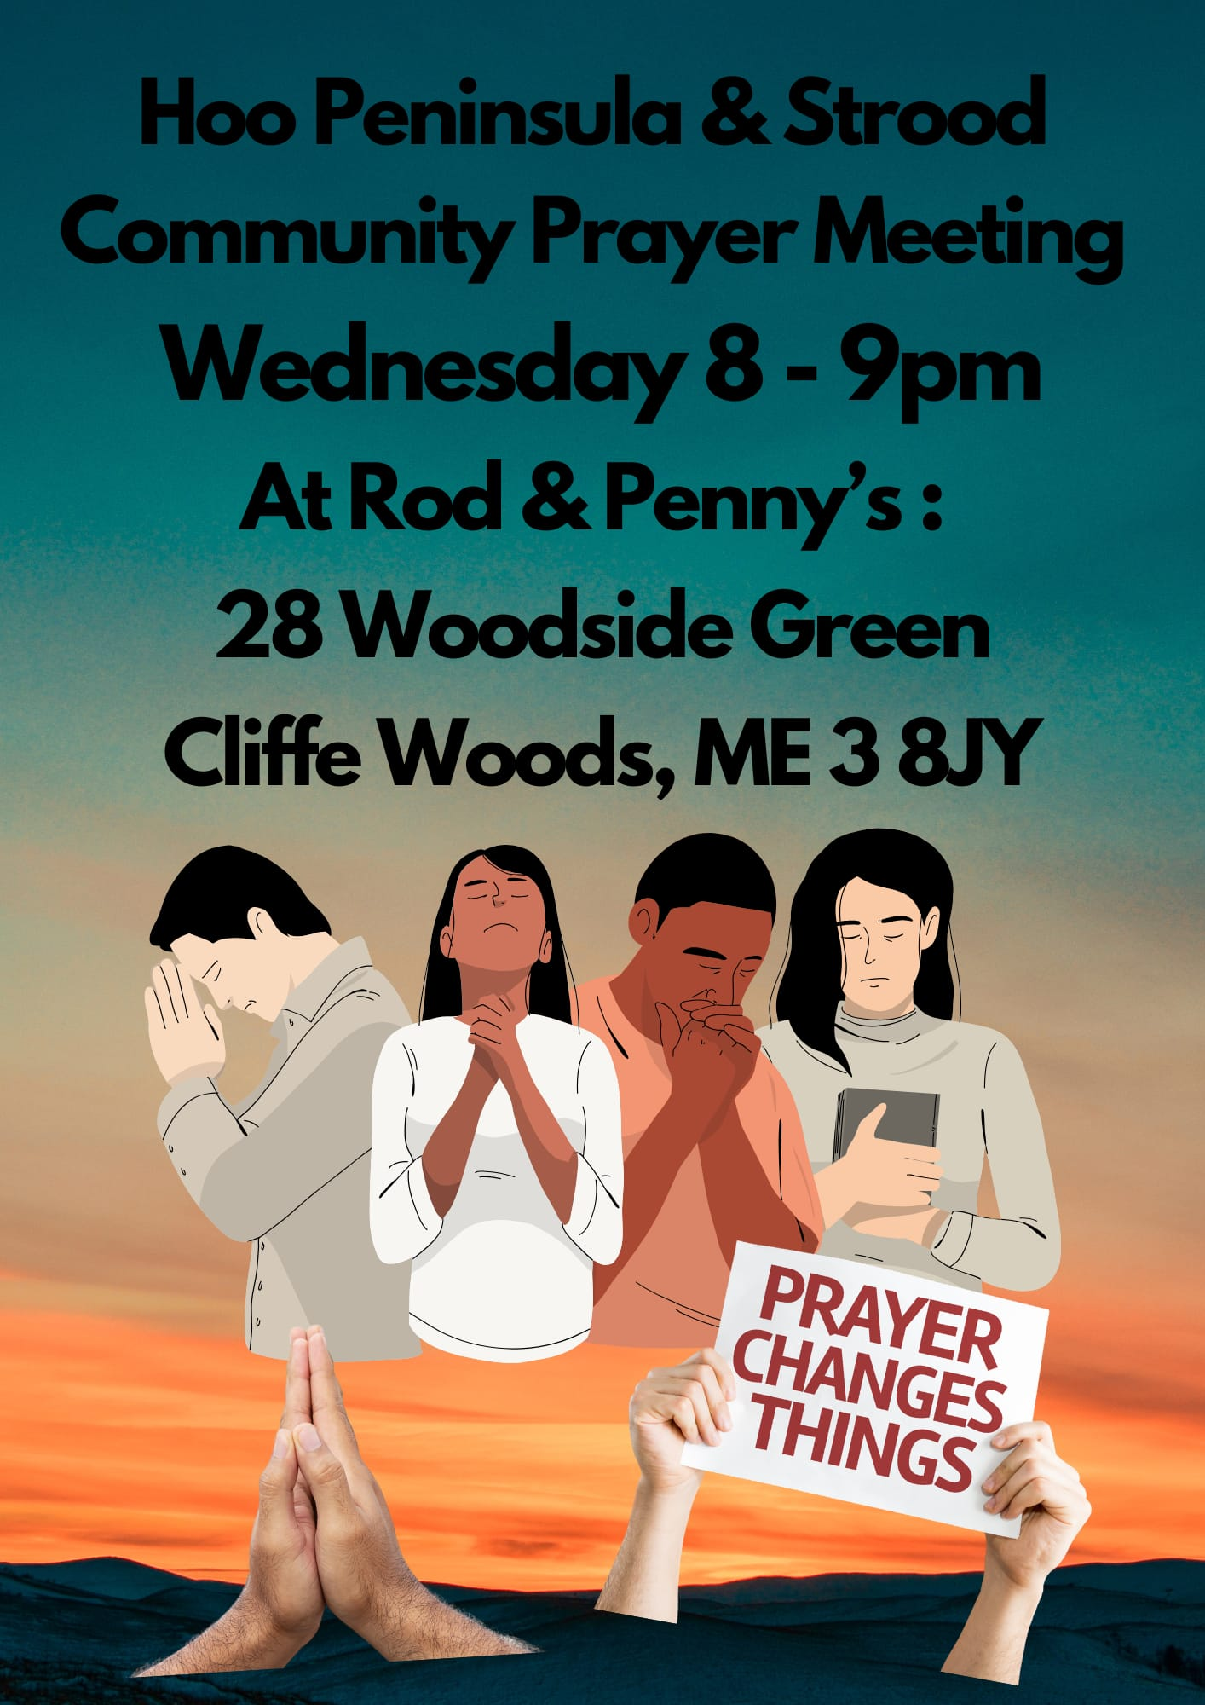

Slide 45
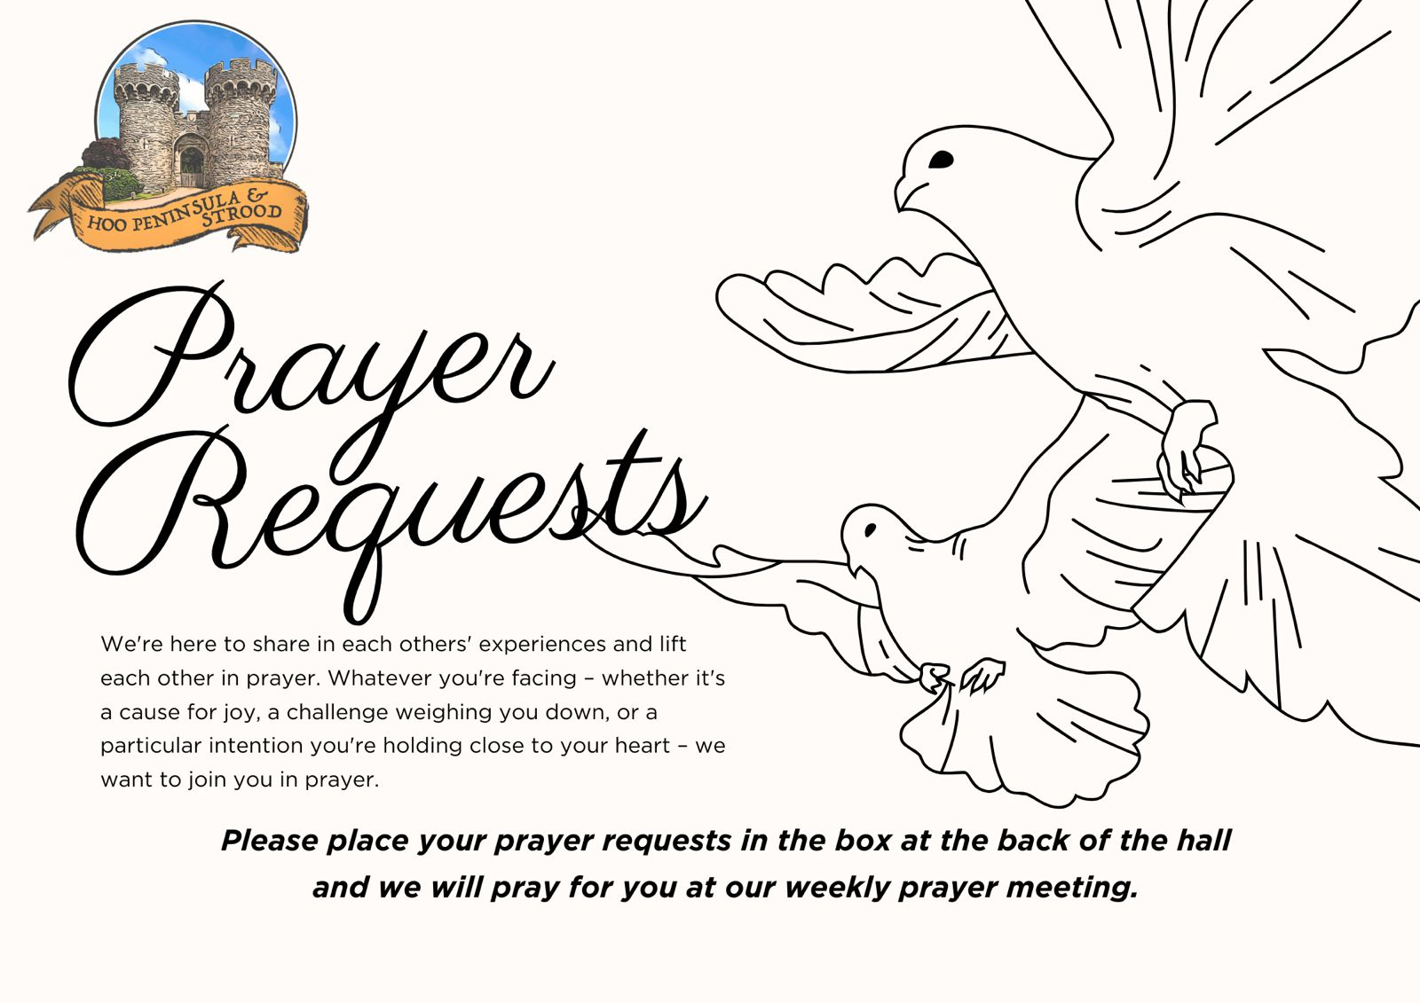

Slide 46
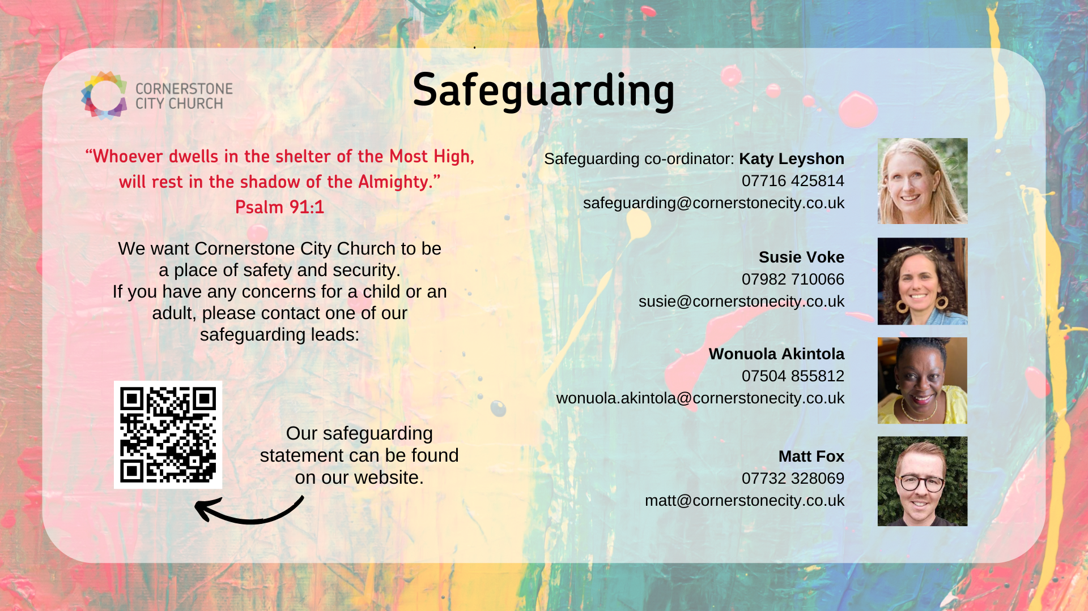

Slide 47
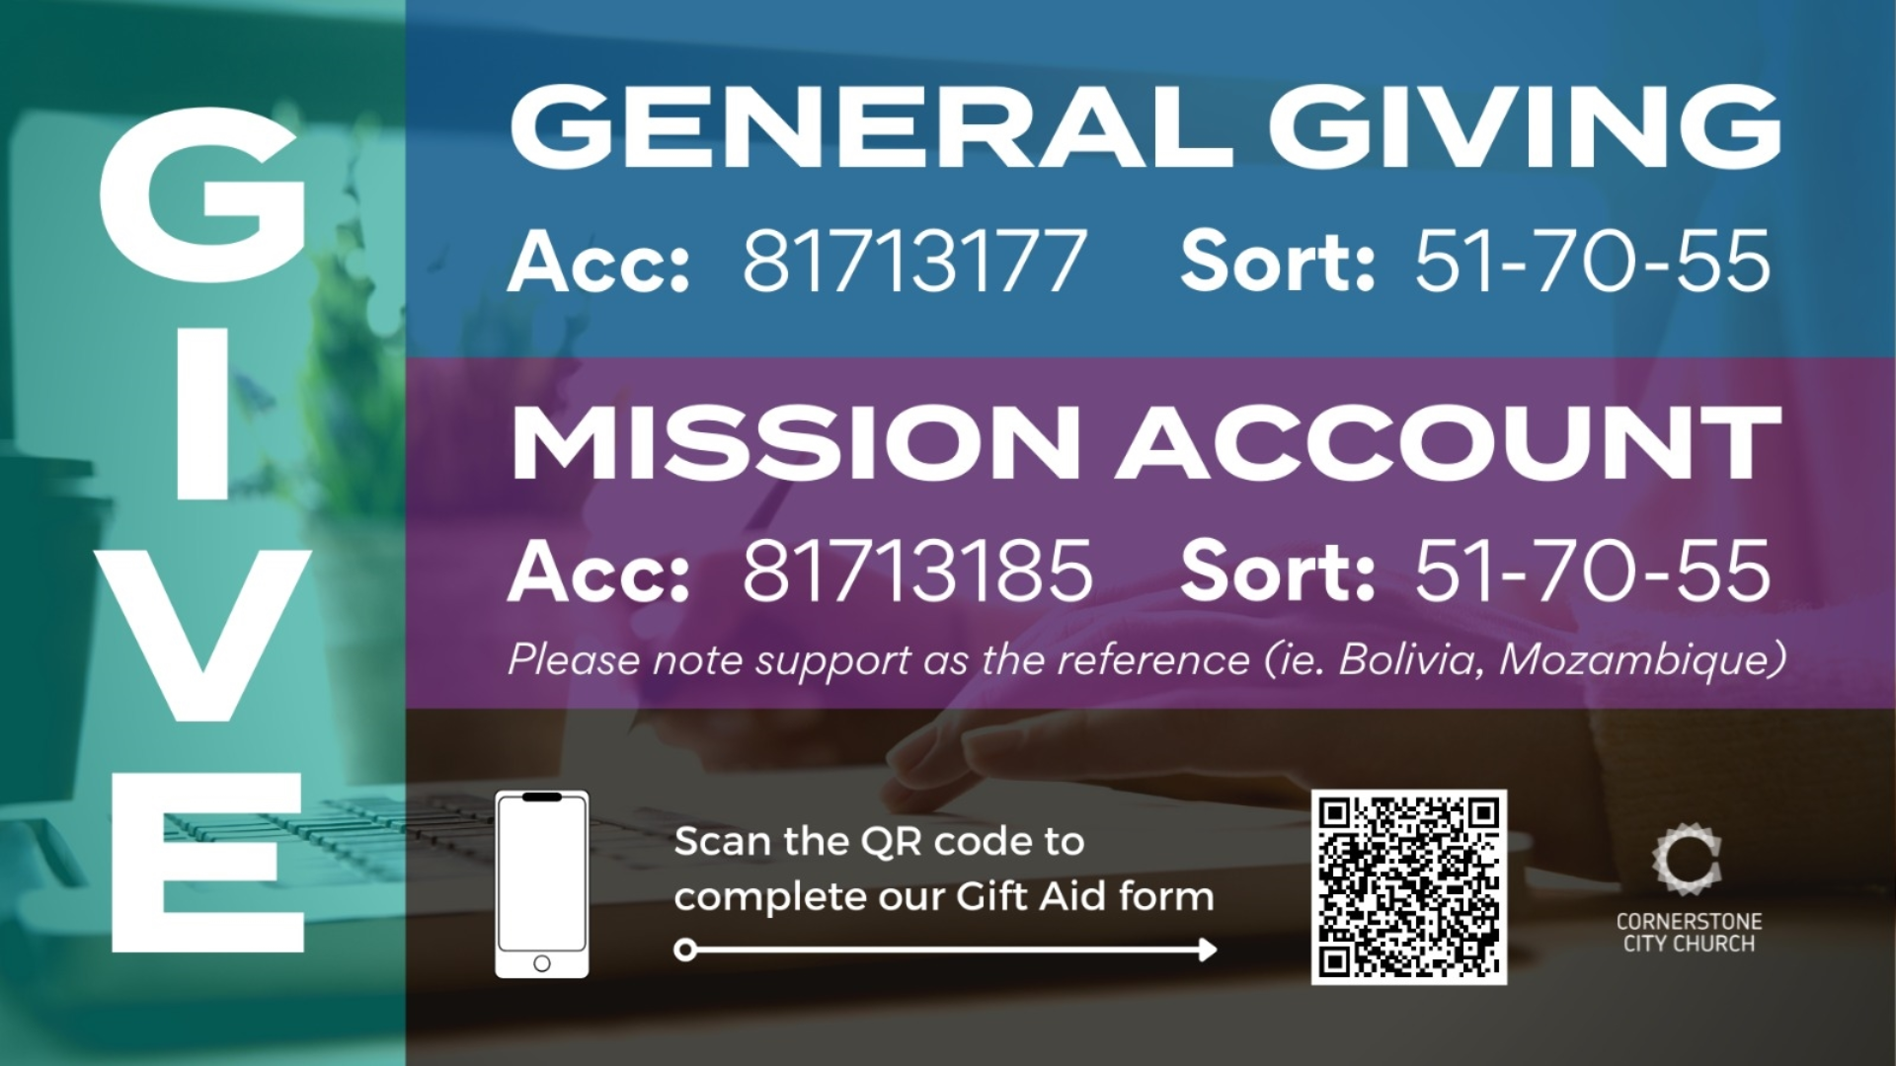

Slide 48
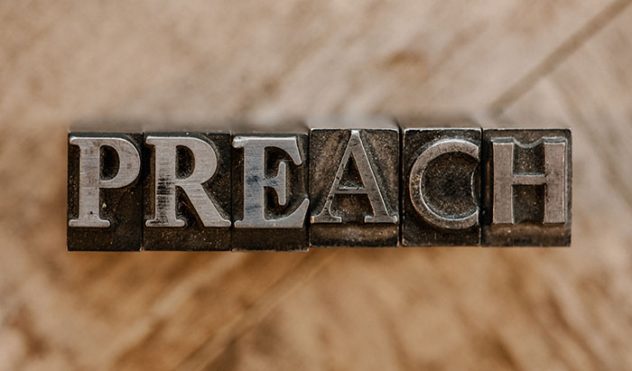

Slide 49
2 Corinthians 14 May the grace of the Lord Jesus Christ, and the love of God, and the fellowship of the Holy Spirit be with us all. And….
Surely goodness and mercy shall follow us all the days of our lives, and we shall dwell in the house of the Lord forever.

